Slide 1
Trends in Liver Cases
By: Abbas, Sam, Ankur, Sai, Haider

Slide 2
Agenda
Outline:
-What was our agenda:
1) finding NA values
2) imputation techniques for missing values
3) preprocessing
4) setting up the predictive model
-Problem statement: How to keep the patient in longer to avoid readmission.

Slide 3
Clean
21 unique VisitLinks of patients
51 patients had disrupted data; their first visit was counted as readmitted
DATA ERRORS

Slide 4
DATA CLEANING
There are lot of blank values about 20,258 sorted in about 8000 rows
Column RACE (Categorical Variable) for location of patients
“6” is given for others so for all the blanks(NA) is mentioned as 6(others)
In few of the columns it is given in character and changed them to numeric to perform the model
Performed machine learning algorithm to find out the best significant columns

Slide 5
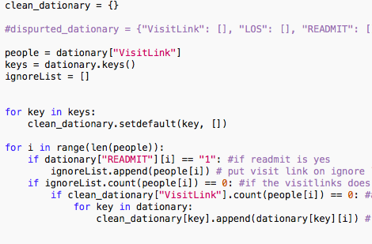
Missing data

Slide 6
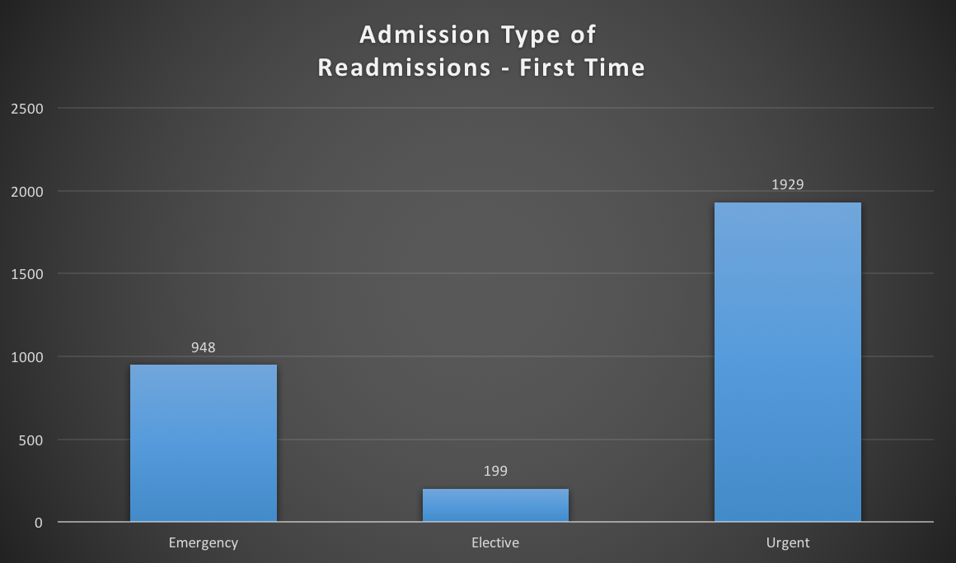

Slide 7
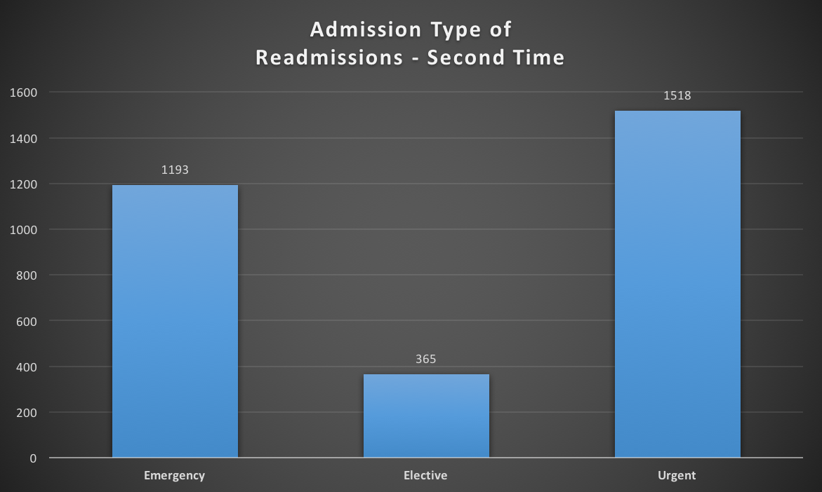

Slide 8
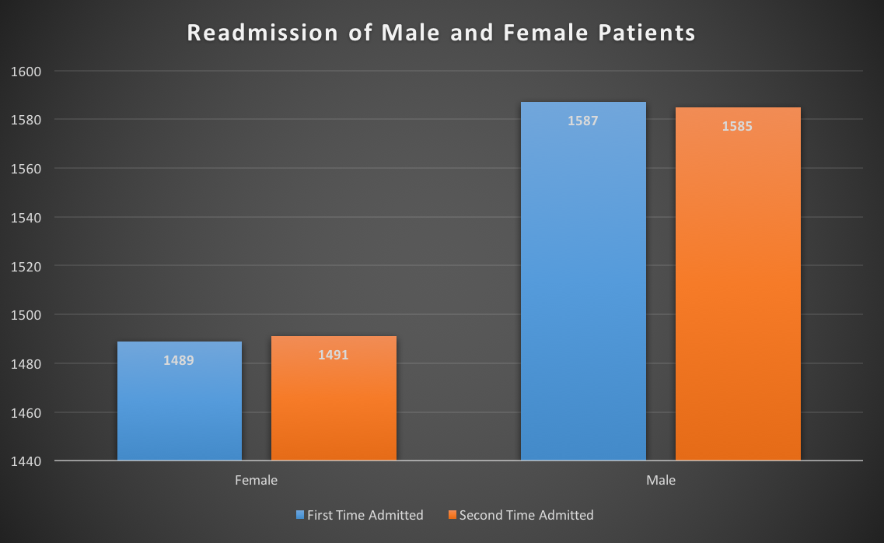

Slide 9
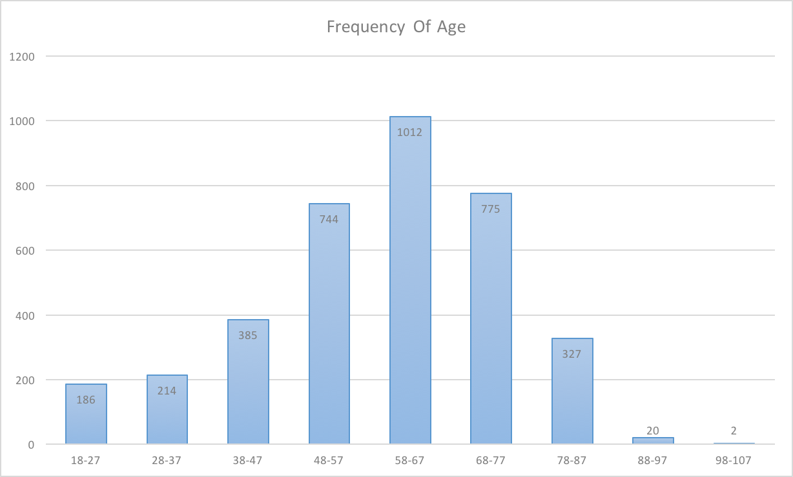
Age
All ages:
Min: 18.00
1st Qu.: 58.76
Median: 60.00
Mean: 58.76
3rd Qu.: 69.00
Max: 112.00
READMIT = 1

Slide 10
Model Built
Preprocessing the Data before filtering and modeling.
Filtered the data according to the correlation plots and trends.
Models to check their accuracy with the data

Slide 11
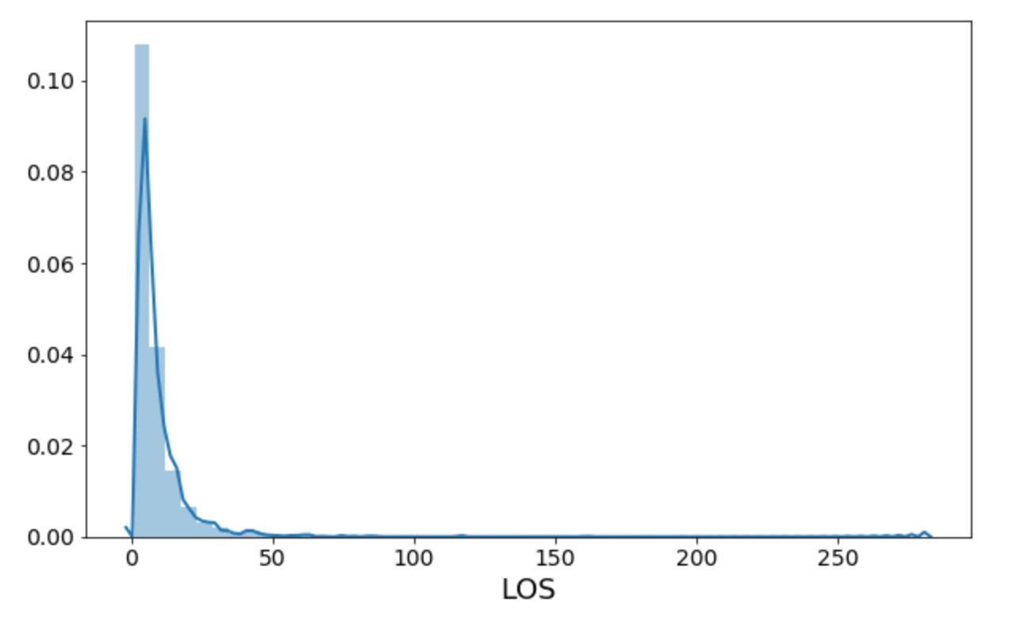
Demographics
‘LOS’ Graphs to check for the histogram skewness.

Slide 12
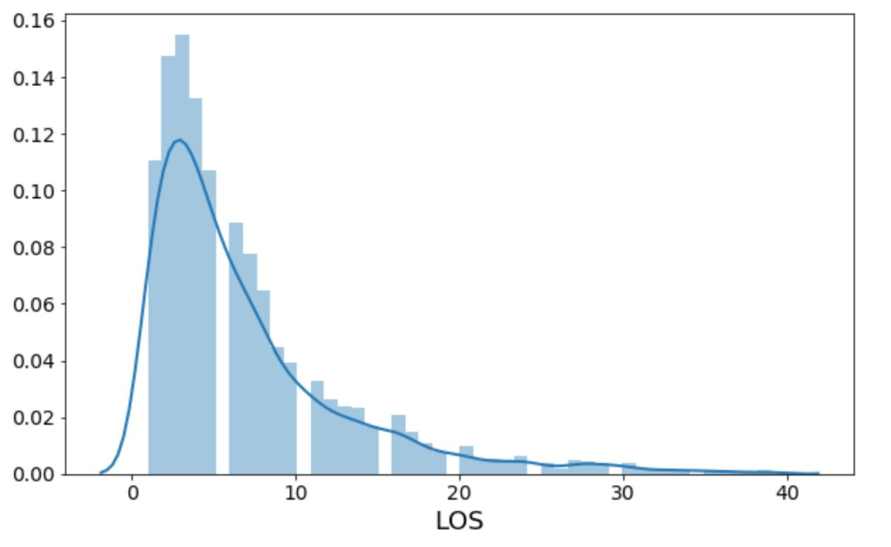
After filtering the ‘LOS’ to reduce the skewness so we can achieve a better accuracy

Slide 13
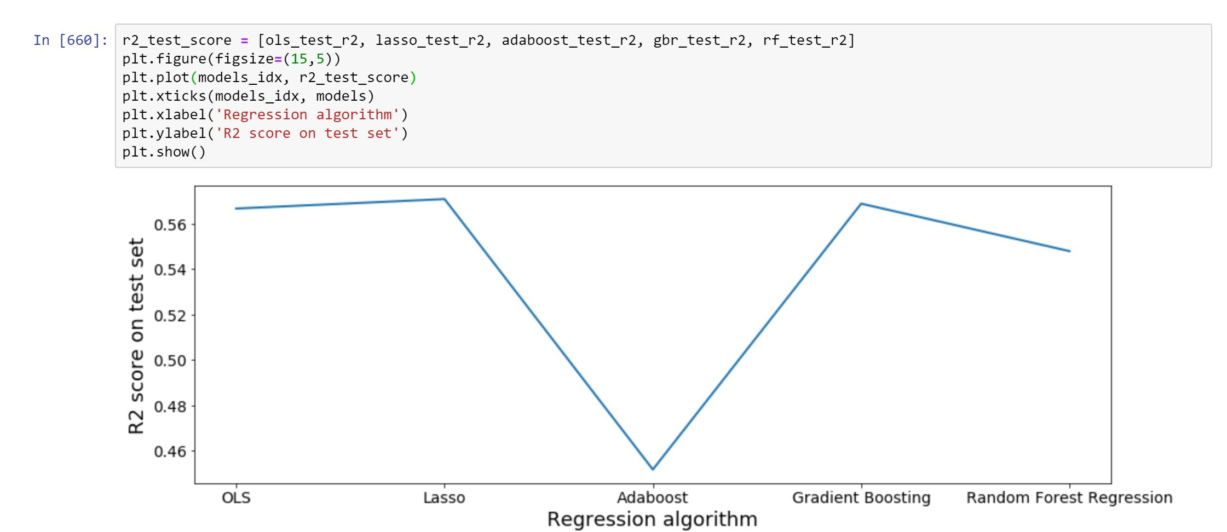
Applied multiple regression model to check how the data reacts to it and check for each one’s accuracy and the mean square error.
Considered OLS, Lasso, Adaboost, Gradient Boosting, RFE

Slide 14
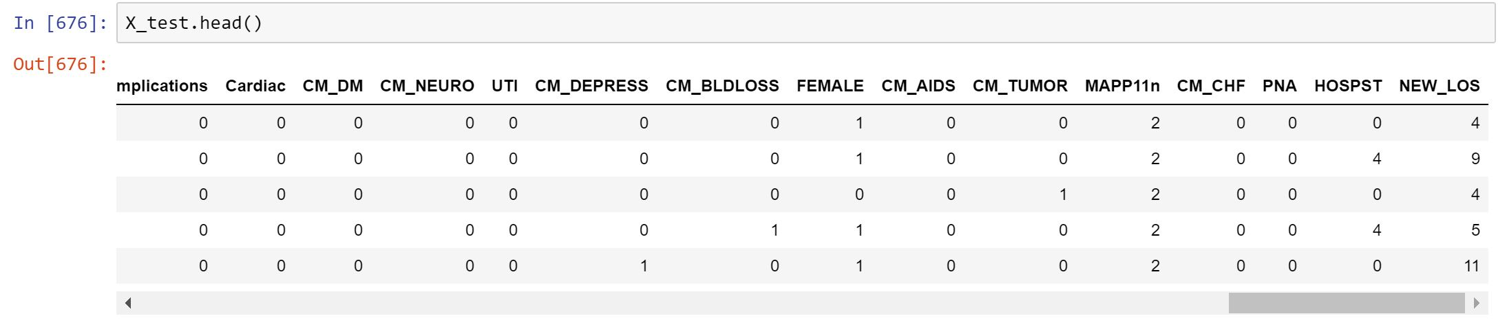
New_LOS column is the predicted column.
Model Lasso Regression predicted the data with 57% accuracy.

